Slide 1
Decoding Emotions: Analyzing Facial Expressions with Intell1Api
Mohit Mehta(2247267)
Tyrell Fernandes(2247237)
Devesh Bhandari(2247111)
Anjali Rai(2247257)

Slide 2
Introduction
What is Intel oneAPI?
Why use Intel oneAPI for Decoding Emotions?
Problem Statement
How we built
Screenshots
Conclusion

Slide 3

INTRODUCTION
Greetings and welcome to our presentation on Intell1Api for face expression sentimental analysis! Today, we'll be exploring the exciting world of sentiment analysis and how it can be used to gain insights into human emotions and behaviors. Have you ever wondered what someone is really thinking or feeling? With Intell1Api, we can analyze facial expressions to determine emotional states such as happiness, sadness, anger, and more. This cutting-edge technology has countless applications in fields such as marketing, psychology, and even law enforcement.

Slide 4

What is Intell1Api?
Intell1Api is a cutting-edge technology that uses artificial intelligence and machine learning to analyze facial expressions and determine the emotions behind them. By analyzing the way a person's face moves, Intell1Api can accurately identify whether they are happy, sad, angry, or any other emotion. One of the most exciting applications of Intell1Api is in the field of sentiment analysis. With this technology, businesses can analyze customer feedback and social media posts to gain insights into how their customers feel about their products or services. This allows them to make data-driven decisions and improve their offerings to better meet customer needs.

Slide 5
Why use Intell1Api for face expression sentimental analysis?
Intell1Api offers a range of benefits for face expression sentimental analysis. One of the key advantages is its ability to accurately detect and analyze even the subtlest expressions, providing insights that might otherwise be missed. This can be especially useful in situations where people are trying to conceal their emotions or when the sentiment being expressed is complex or ambiguous. Another benefit of using Intell1Api is its speed and efficiency. With the ability to analyze large volumes of data quickly and accurately, it can significantly reduce the time and resources required for sentiment analysis. This can be particularly important in industries where real-time analysis is critical, such as finance or marketing.

Slide 6
Problem Statement
In the realm of human-computer interaction and emotional understanding, accurately deciphering and interpreting emotions from facial expressions remains a complex challenge. Traditional methods of emotion recognition often fall short in capturing the intricate nuances and cross-cultural variations inherent in human expressions. Furthermore, the demand for real-time analysis in various applications necessitates a robust and efficient solution.

Slide 7
How we built..
Data collection
Importing oneAPI Packages-(intel-tensorflow,intel-numpy, opencv-python-headless)
Feature Extraction
Model Training
Model Testing
RealTime emotion detection

Slide 8
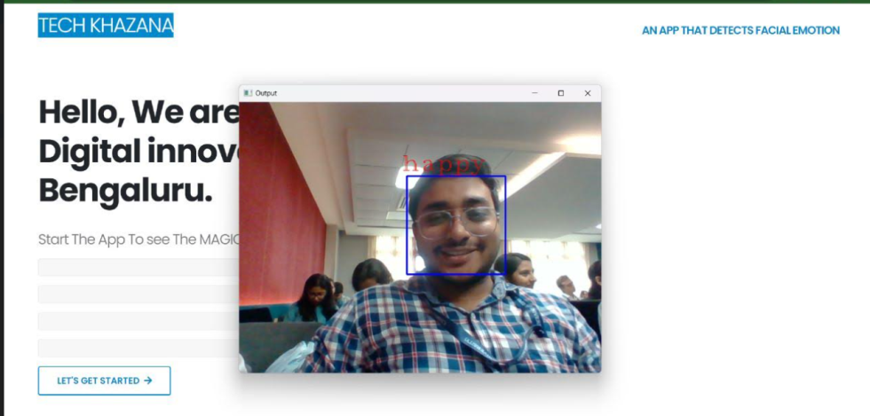
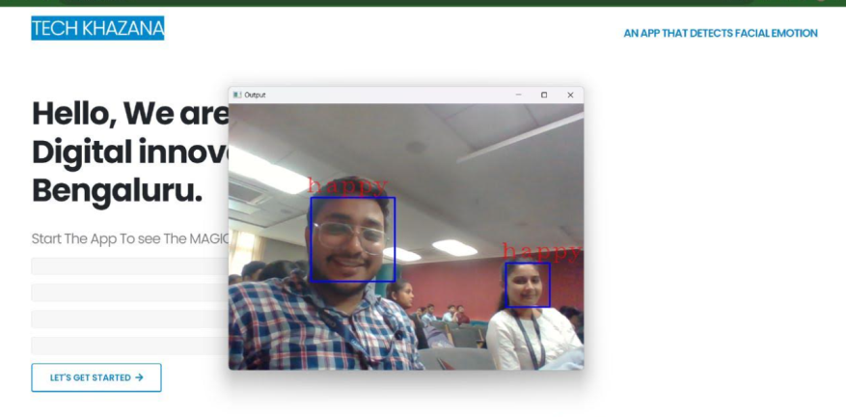
Screenshots

Slide 9
Conclusion
In conclusion, the application of emotion detection using facial expressions has shown promising results with a trained model achieving an accuracy of 0.6202. While this accuracy may not be at the highest level, it signifies a significant step forward in the field of emotion recognition technology. The achieved accuracy suggests that the model is capable of identifying emotions from facial expressions with a moderate degree of reliability. However, it's important to acknowledge the existing limitations, including variations in lighting conditions, facial angles, and individual differences in expressing emotions. Continued research and development in this area can address these challenges and enhance the model's performance, leading to more accurate emotion detection systems.

